Slide 1
程式設計實習(一)

Slide 2
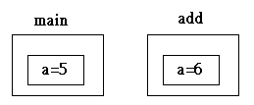
function
int main()
{
int a = 5;
add(a);
}
void add(int a)
{
a++;
}

Slide 3
bubble sort
1 23 6 98 50 4
First round
23 1 6 98 50 4
23 6 1 98 50 4
23 6 98 1 50 4
23 6 98 50 1 4
23 6 98 50 4 1

Slide 4
bubble sort
Second round
23 6 98 50 4 1
23 98 6 50 4 1
23 98 50 6 4 1
23 98 50 6 4 1
And so on

Slide 5
selection sort
1 23 6 98 50 4
98 23 6 1 50 4
98 50 6 1 23 4
98 50 23 1 6 4
98 50 23 6 1 4
98 50 23 6 4 1
98 50 23 6 4 1

Slide 6
Hw 3
Input
Let the user enter ten numbers.
Output
The user enter ten numbers
Sort from large to small(bubble sort)
Sort from small to large(selection sort)

Slide 7
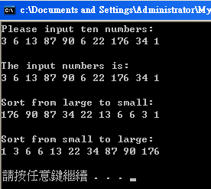
Hw 3

